Slide 1
clustering on co-occurrence graphs
Bob Horton
Microsoft

Slide 2
stackoverflow tagset data
html css css3 internet-explorer-7
c# .net datetime
c# datetime time datediff relative-time-span
html browser timezone timezoneoffset
.net math
c# linq web-services .net-3.5
mysql database binary-data data-storage
performance algorithm language-agnostic unix pi
mysql database triggers
c++ c sockets mainframe zos
arrays actionscript-3 flex
sql sql-server datatable rdbms
c# .net vb.net timer
php plugins architecture hook
html form-submit html-form submit-button
…

Slide 3
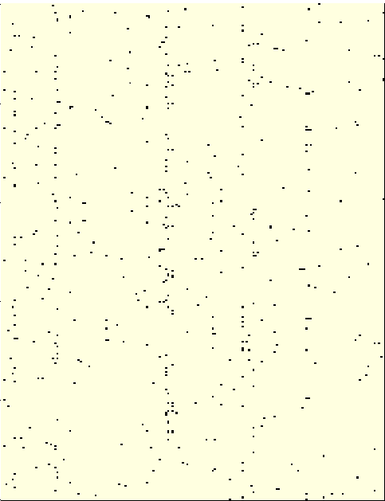
Flags matrix
One column per tag:
.htaccess .net actionscript-3 ajax algorithm amazon-web-services android android-fragments android-layout android-studio angular angularjs apache apache-spark api arrays asp.net asp.net-mvc asp.net-mvc-3 asp.net-mvc-4 authentication azure bash batch-file c c# c++ c++11 class cocoa codeigniter cordova css css3 csv curl database dataframe date datetime debugging delphi dictionary django docker eclipse elasticsearch email entity-framework excel excel-vba express facebook file firebase flash for-loop forms function git go google-app-engine google-chrome google-maps gradle hadoop haskell hibernate html html5 http if-statement image internet-explorer ios ipad iphone java javascript jpa jquery jquery-ui jsf json jsp laravel linq linux list listview logging loops macos magento matlab maven mongodb ms-access multithreading mysql node.js numpy object objective-c oop opencv opengl oracle pandas parsing pdf performance perl php pointers post postgresql powershell python python-2.7 python-3.x qt r react-native reactjs redirect regex rest ruby ruby-on-rails ruby-on-rails-3 scala security select selenium session shell silverlight sockets sorting spring spring-boot spring-mvc sql sql-server sql-server-2008 sqlite ssl string swift swing symfony templates tensorflow tomcat tsql twitter-bootstrap typescript ubuntu uitableview unit-testing unix user-interface validation variables vb.net vba visual-studio visual-studio-2010 wcf web web-services windows winforms wordpress wpf xamarin xaml xcode xml

Slide 4
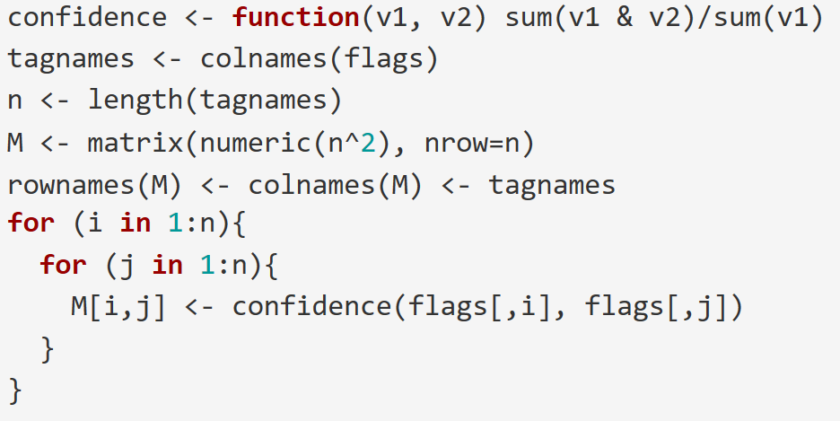
Asymmetric distance matrix
flags is a Boolean matrix, where each column represents a tag, the rows represent a tagset, and the cell is true if the tag is in the tagset.

Slide 5
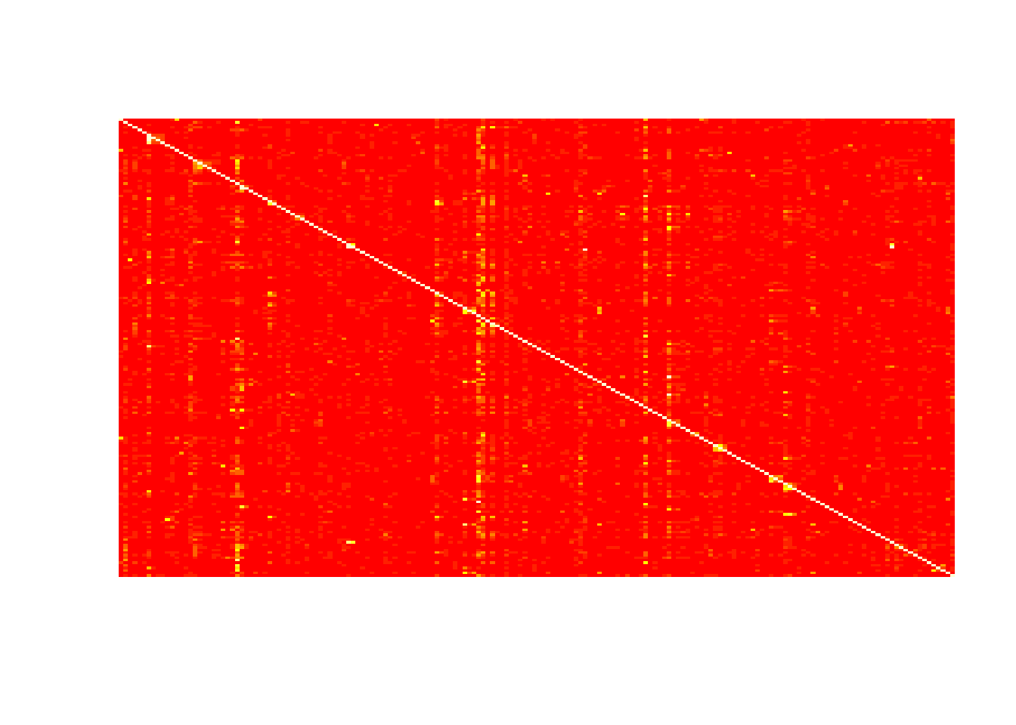

Slide 6
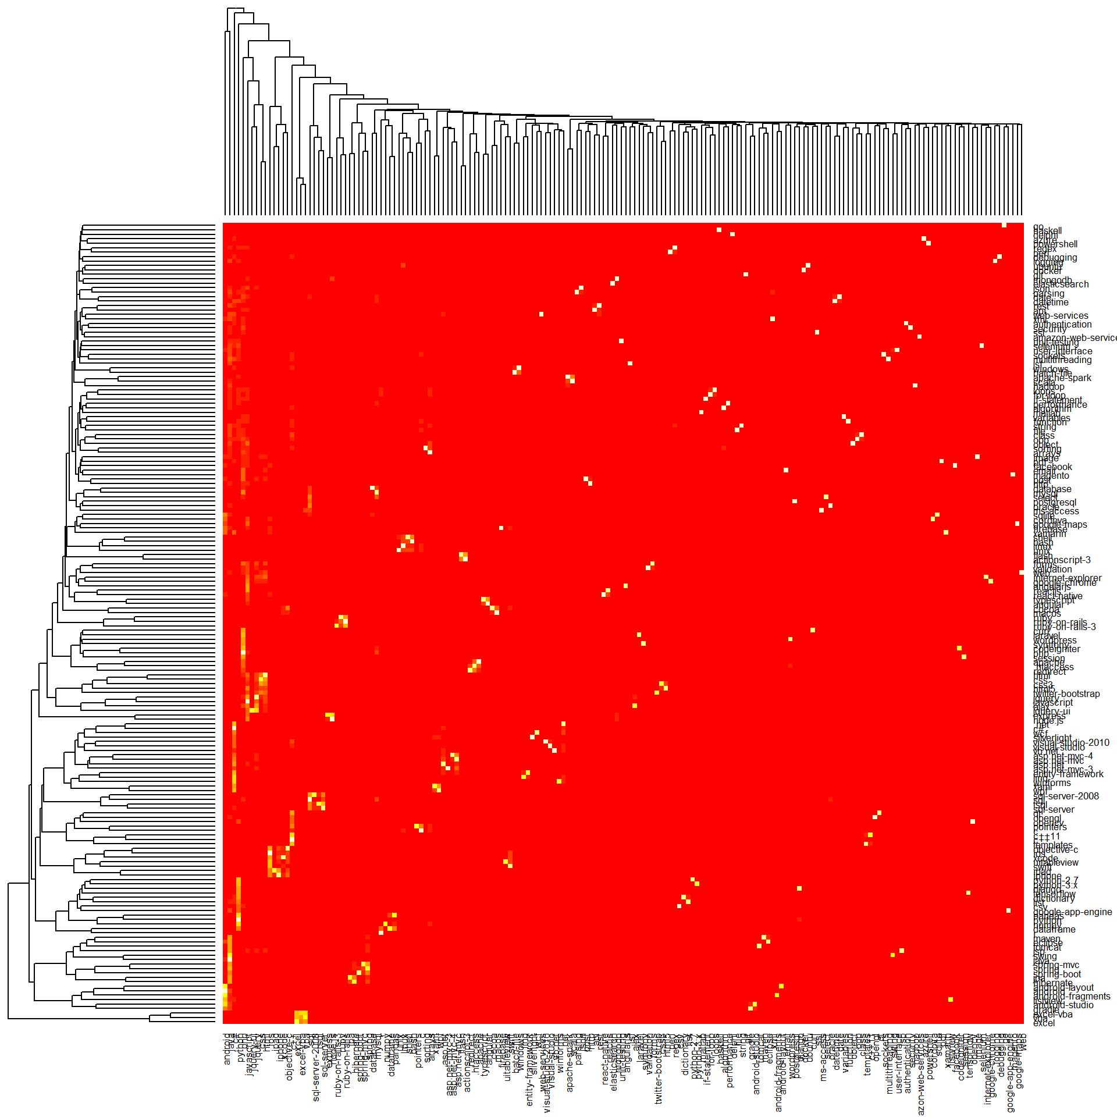

Slide 7
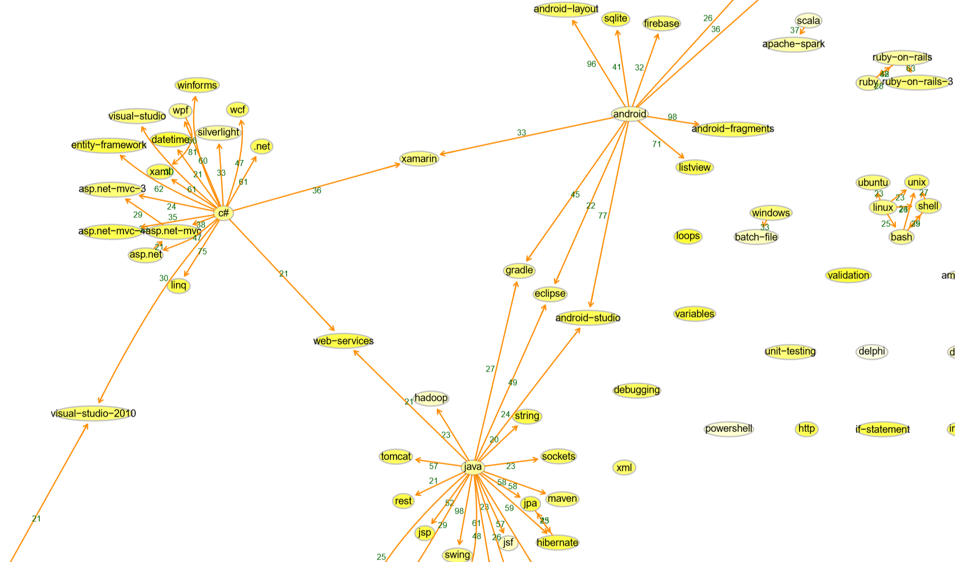

Slide 8
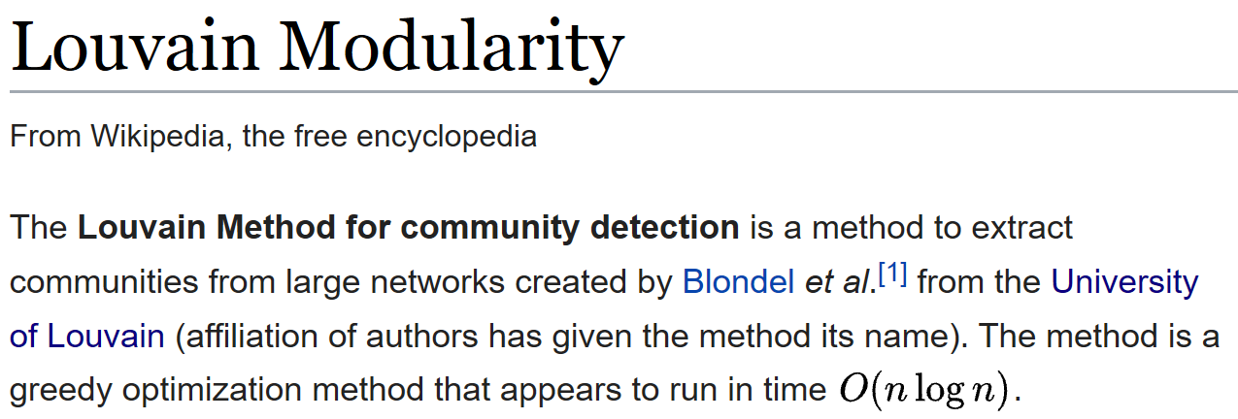
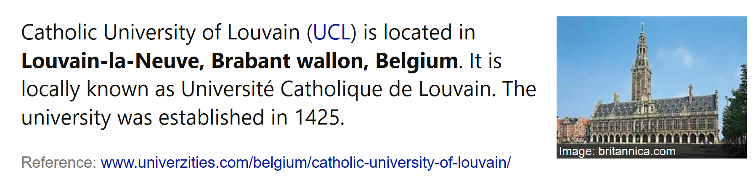

Slide 9





web design
0: html, express, jquery-ui, react-native, html5, parsing, node.js, angularjs, angular, image, jquery, google-chrome, internet-explorer, json, mongodb, object, magento, css3, web, reactjs, twitter-bootstrap, css, javascript, typescript
1: c++11, file, docker, dictionary, sockets, c++, git, google-app-engine, pandas, tensorflow, unix, arrays, opencv, performance, csv, python, class, string, pointers, linux, shell, perl, qt, algorithm, for-loop, c, python-2.7, haskell, templates, bash, function, dataframe, delphi, if-statement, numpy, loops, opengl, regex, ubuntu, django, python-3.x, oop, selenium, matlab, sorting, list, r
2: oracle, postgresql, sql, sql-server-2008, sql-server, database, tsql
3: visual-studio-2010, linq, silverlight, vb.net, asp.net-mvc, .net, datetime, entity-framework, asp.net-mvc-3, wpf, azure, c#, windows, asp.net-mvc-4, asp.net, visual-studio, debugging, powershell, xaml, winforms, wcf, date, pdf, batch-file, web-services
4: firebase, android-fragments, android, android-studio, cordova, xml, android-layout, facebook, listview, sqlite, google-maps, gradle, Xamarin
5: codeigniter, ruby-on-rails, session, curl, rest, amazon-web-services, email, variables, ajax, post, wordpress, security, laravel, forms, validation, api, select, ruby-on-rails-3, redirect, authentication, ruby, mysql, symfony, apache, ssl, php, elasticsearch, http, go, .htaccess
6: logging, multithreading, scala, tomcat, eclipse, swing, jsf, unit-testing, maven, hadoop, user-interface, hibernate, spring-boot, java, spring, spring-mvc, jpa, jsp, apache-spark
7: cocoa, xcode, iphone, objective-c, uitableview, ipad, ios, swift, macos
8: ms-access, excel-vba, vba, excel
9: flash, actionscript-3
software & data science
databases
windows & .net
android
web dev
java
mac & iOS
excel
flash

Slide 10
bonus slides
with example code

Slide 11
collect tagsets from stackexchange archive
sudo apt-get install p7zip-full
wget https://archive.org/download/stackexchange/biology.stackexchange.com.7z
7z e -so biology.stackexchange.com.7z Posts.xml | \
grep 'Tags=' | \
sed -E 's/.*Tags="([^"]+)".*//g' | \
sed 's/&gt;&lt;/ /g' | \
sed 's/&[gl]t;//g' > biology_tagsets.txt

Slide 12
build the graph
library(dplyr)
library(arules)
library(igraph)
tagsets <- 'tagsets/biology_tagsets.txt' %>% read.transactions(quote='')
min_support <- 10/length(tagsets)
rules_df <- tagsets %>%
apriori(parameter=list(support=min_support, conf=0.01, maxlen=2)) %>%
arules::DATAFRAME(separate=TRUE) %>%
filter(!grepl('{}', LHS, fixed=TRUE)) %>%
mutate(LHS=gsub('[\\{\\}]', '', LHS), RHS=gsub('[\\{\\}]', '', RHS))
g <- rules_df %>%
filter(confidence >= 0.2) %>%
select(LHS, RHS, confidence) %>%
graph_from_data_frame

Slide 13
plot the graph
pdf('biology_graph.pdf', height=35, width=35)
g %>% plot(edge.arrow.size=0.5, vertex.color='yellow', vertex.shape='circle', vertex.size=3,
vertex.label.csx=0.01,
layout=function(g) layout_with_graphopt(g, spring.length=0.0001, spring.constant=2, charge=0.0005))
dev.off()

Slide 14
show the clusters
dataframeify <- function(named_vec)
tibble(item=names(named_vec), cluster_id=named_vec)
cluster_assignment_tbl <- g %>%
as.undirected %>%
cluster_louvain %>%
membership %>%
dataframeify %>%
group_by(cluster_id) %>%
summarize(items=paste(item, collapse=',’))
cluster_assignment_tbl

